Slide 1
Treatment Referral in an Opioid Crisis: Opportunities to Engage
Ken Martz, Psy.D. CAS
Special Assistant to the Secretary
Pennsylvania Department of Drug and Alcohol Programs

Slide 2
Overview
Background
Review of process of Warm Handoff
Pending developments
Recommendations/Discussion

Slide 3
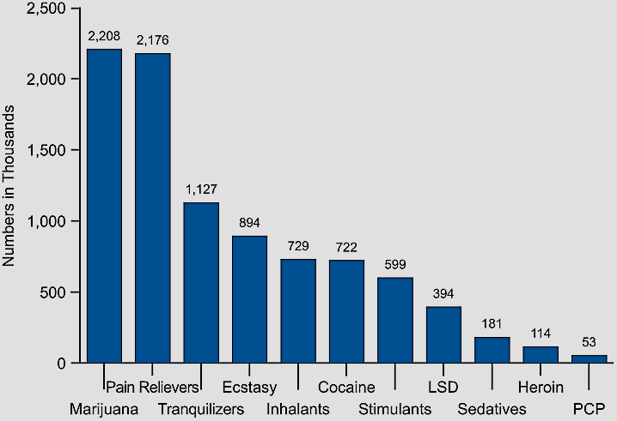
Overview of Substance and Drug Use
Past-Year Initiates for Specific Illicit Drugs Among Persons Age 12 or Older, 2014
Past-Year Initiates for Specific Illicit Drugs Among Persons Age 12 or Older, 2008
Source: Substance Abuse and Mental Health Services Administration. (2009). Results From the 2008 National Survey on Drug Use and Health: National Findings Rockville, Maryland.

Slide 4
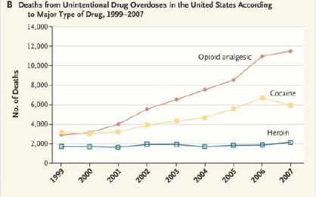
Source: Okie (2010). New England Journal of Medicine

Slide 5
Drug Related Overdose Deaths in Pennsylvania

Slide 6
The Solution- Think Comprehensive
Prevention
Primary Prevention Services
Pennsylvania Prescriber Practice Guidelines
Safe Storage Procedures
Permanent Drop Boxes for medication disposal
Intervention
Prescription Drug Monitoring Program
Warm Handoff to SUD supports/treatment
Treatment
Licensed Substance Use Disorder Treatment Services
Recovery
Recovery Management Supports
Notes:
_______________________________________________________
_______________________________________________________
_______________________________________________________
_______________________________________________________
_______________________________________________________
_______________________________________________________
_______________________________________________________
_______________________________________________________

Slide 7
The Solution- Prescribing Guidelines
Prescribing Practices Workgroup
Formed in 2013 led by Secretary of Pennsylvania Department of Drug and Alcohol Programs (DDAP) co-chaired by Physician General of Pennsylvania.
Included a broad range of public and private stakeholders including:
Federal
SAMHSA
State
Department of Drug and Alcohol Programs
Department of Health
Department of State
Department of Human Services
Department of Insurance
Department of Military and Veterans Affairs
Public
Universities
Medical Associations: Physicians, Ostpeopaths, Nurses, Dentists
Hospitals
Physicians
Notes:
_______________________________________________________
_______________________________________________________
_______________________________________________________
_______________________________________________________
_______________________________________________________
_______________________________________________________
_______________________________________________________
_______________________________________________________

Slide 8
The Solution- Prescribing Guidelines
Prevention
Pennsylvania Prescriber Practice Guidelines
Emergency Department Pain Treatment Guidelines
Use of Opioids to Treat Non-Cancer Pain
Use of Opioids in Dental Practices
Obstetrics and Gynecological Pain Treatment
Geriatric Pain: Opioid Use and Safe Prescribing
Opioid Dispensing Guidelines
Use of Addiction Treatment Medications in the Treatment of Pregnant Patients with Opioid Use Disorder
Pending Finalization
Benzodiazepines
Future plans
Sports Medicine
Pediatrics
?
Notes:
_______________________________________________________
_______________________________________________________
_______________________________________________________
_______________________________________________________
_______________________________________________________
_______________________________________________________
_______________________________________________________
_______________________________________________________

Slide 9
The Solution- Prescribing Guidelines
Research: Practice Guidelines
Leads to reduction in prescribing of opioids
29% immediate reduction after implementation (Del Portal, et al., 2015)
Gains are sustained over time
33% reduction one year after implementation (Del Portal et al., 2015)
Goal to reduce advancement of SUD development
Drivers
Focus on Pain Cessation rather than Patient Functionality
Patient Satisfaction
Fiscal Incentives for Patient Satisfaction
Lack of Prescriber Education in SUD
Lack of Prescriber Education in alternatives
Notes:
_______________________________________________________
_______________________________________________________
_______________________________________________________
_______________________________________________________
_______________________________________________________
_______________________________________________________
_______________________________________________________
_______________________________________________________

Slide 10
Prescribing Guidelines: 7 Steps

Slide 11
Prescribing Guidelines: 7 Steps
Emergency providers should not prescribe long acting opioid agents such as OxyContin®, extended-release morphine, or methadone, unless coordinated with the outpatient provider.
The patient should not receive opioid prescriptions for chronic or recurrent pain from multiple providers.
Upon development of a controlled substances database by the Commonwealth of Pennsylvania, emergency providers should access this as indicated.
Emergency providers should not replace lost or stolen prescriptions for controlled substances.
Emergency providers should not fill prescription for patients who run out of pain medications; refills are to be arranged with the primary or specialty prescribing provider.
Patients whose behavior raises the provider’s concern for addiction should be encouraged to seek detoxification assistance, and emergency department staff should provide information to assist in this process.

Slide 12
Prescribing Guidelines: 7 Steps
Opioid analgesics may be appropriate for acute illness or injury.
Discharge prescriptions should be limited to the amount needed until follow-up and typically should not exceed seven days.
When selecting a medication for pain control, the provider should consider non-opioid medications as alternative or concurrent therapy.
When opioids are indicated, the provider should choose the lowest potency opioid necessary to relieve the patient’s pain.
An emergency department provider should only dispense the amount of opioid medication needed to control the patient’s pain until they are able to access a pharmacy.

Slide 13
Progression of a Disease and Recovery
Prevention
(Relapse)Prevention
No addiction
Late Recovery
Outpatient Treatment
Give to others
Optimism
Regain job
Face problems
Honesty
More relaxed
Relationships improve
Begin to develop trust
Resolve legal issues
Self respect returning
Connect with sponsor/
positive peer group
Self examination
Medical stabilization
Thinking begins to clear
Desire for help
No drinking
Social drinking
Drinking feels good
Drink to relax
Drink to escape
Withdrawal from friends
First DUI
Conflict in relationships
Missed time from work
Regular drinking
Amount of drinking increases
Drink to stop feeling bad
Disciplinary action at work Association with negative peer group
Antisocial beliefs justify behaviors
Increasing health complications
Relationship isolation/ alienation
Early Addiction
Middle Recovery
Intensive Treatment
Middle Addiction
Early Recovery
Late Addiction
“Rock Bottom”, Arrests
Divorce, Loss of Job
Depression,
Hopelessness,
Suicide, Death

Slide 14
Patient Engagement
When using these guidelines, the approach may vary based on where the patient is in the progression of SUD.
In emergency situations there is limited time for engagement
Some key elements of patient engagement include:
Set the tone by displaying genuine interest with active listening.
Ask open-ended and non-judgmental questions, eg:
Ask: What impact has alcohol had on your life?
Rather than: Do you have an alcohol problem?
Be clear and direct in recommendations, just like other medical recommendations
Be knowledgeable about a range of offerings such as how to access treatment locally, connections for funding assistance etc.
When available, persons in recovery can be a valuable asset to engage these conversations.
Close the discussion with a positive connection, whether or not the patient agrees to the recommended plan. (Doing so can help them re-engage when they are ready)

Slide 15
Elements of the Warm Handoff
County Drug and Alcohol Agency (SCA) helps ensure active funding stream (e.g. Medicaid, county funding, etc). These are front door to SUD treatment access.
Their role is to identify payment sources, to complete an initial assessments, and to connect individuals to treatment
DDAP has led efforts to address each of these areas, with specific action steps.
Client
Medical Providers
SUD Treatment

Slide 16
Evidence Based Practice
Warm handoff procedures are evidence based as an effective approach with substantial research support
O'Neil, S. H. (2009). Addiction treatment providers needed for 'warm handoff' from EDs. Alcoholism & Drug Abuse Weekly, 21(38), 1-3.
Koenig, C. J., Maguen, S., Daley, A., Cohen, G., & Seal, K. H. (2013). Passing the baton: A grounded practical theory of handoff communication between multidisciplinary providers in two department of veterans affairs outpatient settings. Journal of General Internal Medicine, 28(1), 41-50.
Boudreaux, Edwin D., Haskins, B., Harralson, T., & Bernstein, E. (2015) The remote brief intervention and referral to treatment model: Development, functionality, acceptability, and feasibility, Drug and Alcohol Dependence, 155(1), 236-242.
Sammer, J. (2015). Warm handoffs serve as the first step toward accountable care. Behavioral Healthcare, 35(3), 24-27.
Bernstein, E., Ashong, D., Heeren, T., Winter, M., Bliss, C., Madico, G., & Bernstein, J. (2012). The impact of a brief motivational intervention on unprotected sex and sex while high among drug-positive emergency department patients who receive STI/HIV VC/T and drug treatment referral as standard of care. AIDS and Behavior, 16(5), 1203-16.
Bernstein, S. L., & D'Onofrio, G. (2013). A promising approach for emergency departments to care for patients with substance use and behavioral disorders. Health Affairs, 32(12), 2122-8.

Slide 17
Models of Warm Handoff
DDAP conducted a survey of existing practices in Pennsylvania, in other states, and the literature to identify best practices. Key models are:
SUD Professional Models: The SCA, their designee or treatment provider, offer immediate access to screening, assessment and referral.
Recovery Models: Certified Recovery Specialists or volunteers from the recovery community (e.g. peer support groups) staff emergency rooms or phone lines at key times to help transition patients to SUD treatment.
Hospital Based Models: Hospital staff coordinate referrals similar to the process done with other acute medical conditions such as transfers to nursing homes and physical rehabilitation.

Slide 18
Considerations
Factors to consider:
Implementation
Relationship building between partners
Addressing stigma
Managing costs
Referral Resources
Choosing procedures that work locally
Treatment availability
Funding for treatment
Maintenance
Create practices that are easy for the workflow

Slide 19
Action Steps/Workflow
Client Presents
Screen for SUD :
Based on positive screening results, provide intervention or referral to treatment
Use motivational enhancement language to engage
May be initiated by embedded staff or collaborations (eg. nurse, peer specialists, collaborations with SUD treatment providers etc.)
Screen for medication interactions:
Check PDMP
Prescribe in accordance with appropriate Guidelines
Followup care:
Use warm handoff and referrals to appropriate care
Where appropriate, co-prescribe naloxone
Provide information on safe medication storage and disposal
Considerations:
Use warm handoff and referrals to appropriate care
For difficult cases/ cases not responding to treatment as expected, check for SUD.
For patients at risk of addiction use caution with all potentially addictive medications (consider opiates, stimulants, benzodiazepines etc.). Consider alternatives. Consider safety of dosage practices.

Slide 20
Contact Information
Ken Martz, Psy.D. CAS
Special Assistant to the Secretary
Pennsylvania Department of Drug and Alcohol Programs
903 Health and Welfare Building
625 Forster St
Harrisburg, PA 17120
KeMartz@pa.gov
(717) 547-3323

